Slide 1
SQL Subqueries

Slide 2
Subqueries
A subquery is a SQL query within a query.
They are nested queries that provide data to the enclosing query.
Subqueries can return individual values or a list of records.
Note that subquery statements are enclosed between parenthesis.
A subquery may be included whithin:
Select commands in From, Where, and Having statements In another subquery In Insert, Delete, Update commands

Slide 3


Subqueries
Example:
Display books were published in 2008. There are three options for solving this task:
1. Write a query that outputs numbers for books published in 2008. Then write a second query that shows the titles of the books according to the numbers received.
SELECT BookId
FROM Title_page
WHERE YearOfPub=2008;
SELECT Title
FROM Books
WHERE BookId IN (63, 64);

Slide 4
Subqueries
Example:
Display books were published in 2008. There are three options for solving this task:
Use table JOIN.
SELECT b.Title
FROM Books b INNER JOIN Title_page t ON (b.BookId=t.BookId)
WHERE t.YearOfPub=2008;

Slide 5
Subqueries
Example:
Display books were published in 2008. There are three options for solving this task:
Use Subquery.
SELECT Title
FROM Books
WHERE BookId IN (
SELECT BookId
FROM Title_page
WHERE YearOfPub=2008);

Slide 6
Subqueries
The structure of the subquery is the same as the structure of the Select command. However, there are some differences:
no semicolon is required at the end of a subquery
the subquery usually does not contain an ORDER BY statement
In the Select statement of a subquery, you can use columns from tables that are defined in the From statement of a query

Slide 7
Subqueries
Most commonly subqueries are included in the WHERE sentence of the SELECT command. In this case, the WHERE sentence takes one of the following forms: WHERE column OPERATOR (subquery);
WHERE column OPERATOR [NOT] IN (subquery);
Where:
OPERATOR – comparison operator (<, <=, >, >=, <>, =)
[NOT] IN – verifies that the value is included in the set of values ​​selected by the subquery
Many queries that contain subqueries can be converted to queries with table JOINS, but there are tasks that can only be solved by subqueries.

Slide 8
Simple and complex subqueries
Simple Query – A query that can be executed separately, regardless of the command in which it is built in.
Simple query execution sequence:
execution of the subquery.
its result is used to process external query.
SELECT Title
FROM Books
WHERE BookId IN (
SELECT BookId
FROM Title_page
WHERE YearOfPub=2008);

Slide 9
Simple and complex subqueries
A complex subquery is not considered separately from the command in which it is built in. A complex internal query is used when you need to process an internal query table for each row in an external query. A complex query has a different structure and a different execution sequence.
Structure:
SELECT external table columns
FROM external table
WHERE external column IN (
SELECT internal table columns
FROM internal table
WHERE internal column = external column);

Slide 10
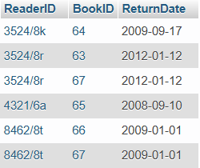
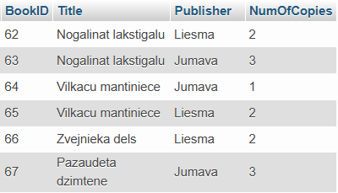
Simple and complex subqueries
Example: Two tables are given: Books_taken and Books. Write a query that displays the name of books which copies remained in the library.

Slide 11
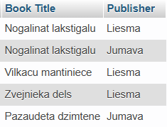
Simple and complex subqueries
Example: Two tables are given: Books_taken and Books. Write a query that displays the name of books which copies remained in the library.
SELECT b.Title AS `Book Title`, b.Publisher
FROM Books b
WHERE b.NumOfCopies > (
SELECT Count(bt.BookID)
FROM Books_taken bt
WHERE bt.BookID = b.BookId);

Slide 12
Simple and complex subqueries
Query execution order: subquery is executed for each external query record!
SELECT b.Title AS `Book Title`, b.Publisher
FROM Books b
WHERE b.NumOfCopies > (
SELECT Count(bt.BookID)
FROM Books_taken bt
WHERE bt.BookID = b.BookId);

Slide 13
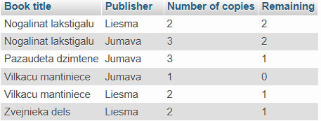
Practice
1. Create a query that outputs information about books that are currently in the library:
Book Title how many books are in the library at all how many books remained in the library

Slide 14
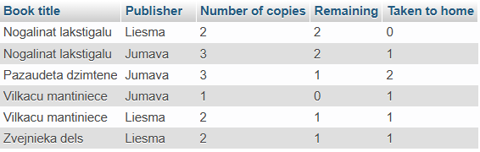
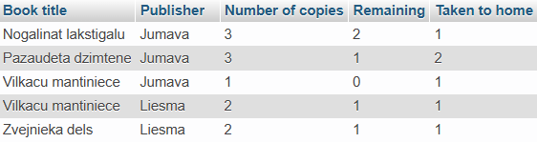
Practice
Update the 1st task so that you can also see how many books have been taken home
Update 2nd task so that you can see only those books that have been taken at least one copy.

Slide 15



Practice
Journal table stores information about the services provided during the year. How many times was each type of service provided and what amount of money was received for each type of service?
At the beginning, I recommend to calculate the Internet and MS Office, because of hourly payment.
Then copying because payment is collected by copied pages
Then merge (Union).

Slide 16
Answers
1.
SELECT b.Title AS `Book title`,
b.Publisher AS `Publisher`,
b.NumOfCopies AS `Number of copies`,
b.NumOfCopies -(
Select Count(bt.BookID)
FROM Books_taken bt
WHERE bt.BookID=b.BookId) AS Remaining
FROM Books b
ORDER BY b.Title;
2.
SELECT b.Title AS `Book title`,
b.Publisher AS `Publisher`,
b.NumOfCopies AS `Number of copies`,
b.NumOfCopies-(
Select Count(bt.BookID)
FROM Books_taken bt
WHERE bt.BookID=b.BookId) AS Remaining, (
Select Count(bt.BookID)
FROM Books_taken bt
WHERE bt.BookID=b.BookId) AS `Taken to home`
FROM Books b
ORDER BY b.Title;

Slide 17
Answers
3.
SELECT b.Title AS `Book title`,
b.Publisher AS `Publisher`,
b.NumOfCopies AS `Number of copies`,
b.NumOfCopies-(
Select Count(bt.BookID)
FROM Books_taken bt
WHERE bt.BookId=b.BookId) AS Remaining, (
Select Count(bt.BookID)
FROM Books_taken bt
WHERE bt.BookId=b.BookId) AS `Taken to home`
FROM Books b
WHERE (
Select Count(bt.BookId)
FROM Books_taken bt
WHERE bt.BookId=b.BookId) <> 0
ORDER BY b.Title;

Slide 18
Answers
4.
SELECT s.ServiceName AS `Service`, (
SELECT Count(j.ServiceId)
FROM Journal j
WHERE j.ServiceId = s.ServiceId
GROUP BY j.ServiceId
) AS `Number`,
s.Price * (
SELECT Sum(TIMESTAMPDIFF(HOUR, SStartTime, SFinishTime))
FROM Journal j
WHERE j.ServiceId = s.ServiceId
GROUP BY j.ServiceId
) AS `Amount of money`
FROM Services s
WHERE s.ServiceName NOT LIKE 'Copy%'
UNION
SELECT s.ServiceName AS `Service`, (
SELECT Count(j.ServiceId)
FROM Journal j
WHERE j.ServiceId = s.ServiceId
GROUP BY j.ServiceId
) AS `Number`,
s.Price * (
SELECT Sum(j.NumOfCopies)
FROM Journal j
WHERE j.ServiceId = s.ServiceId
GROUP BY j.ServiceId
) AS `Amount of money`
FROM Services s
WHERE s.ServiceName LIKE 'Copy%'
ORDER BY `Service`;

